Slide 1
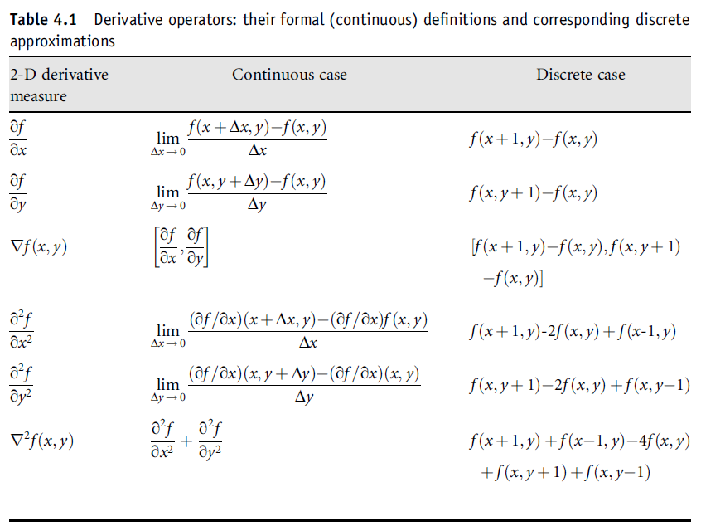
Derivatives-Gradients (Revisited)
COMSATS University Islamabad, Lahore Campus Digital Image Processing CSD 331

Slide 2
Geometric Transformations (Revisited)
COMSATS University Islamabad, Lahore Campus Digital Image Processing CSD 331

Slide 3
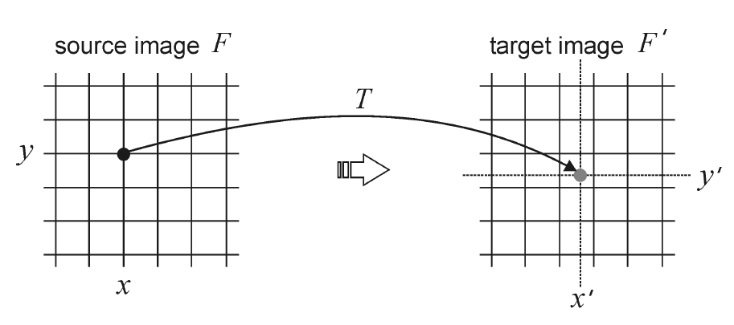
Geometric Spatial Transformations
Forward Mapping
COMSATS University Islamabad, Lahore Campus Digital Image Processing CSD 331

Slide 4
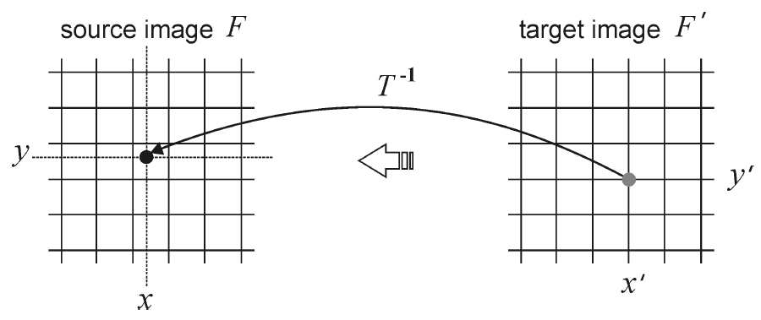
Geometric Spatial Transformations
Reverse Mapping
COMSATS University Islamabad, Lahore Campus Digital Image Processing CSD 331

Slide 5
Geometric Spatial Transformations (Rubber Sheet)
Forward Mapping
Scan through the source image pixel by pixel, and copy them to the appropriate place (as per transformation) in the destination image.
Some pixels in destination image don’t get any value (Gaps)
Some pixels in destination image get multiple values (Overlaps)
Reverse Mapping
Go through the destination image pixel by pixel, and sample the correct pixel from the source image by inverse of transformation.
COMSATS University Islamabad, Lahore Campus Digital Image Processing CSD 331

Slide 6
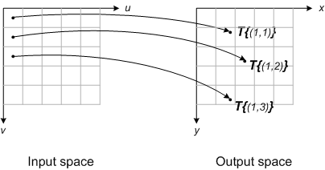
Forward Mapping
Consider each input image pixel in turn. For each input image pixel:
Determine its location in input space, (u_{k},v_{k}).
Map that location to output space using (x_{k},y_{k}) = T{(u_{k},v_{k})}.
Figure out which output pixel contains the location (x_{k},y_{k}).
Copy the input pixel value to that output pixel.
COMSATS University Islamabad, Lahore Campus Digital Image Processing CSD 331

Slide 7
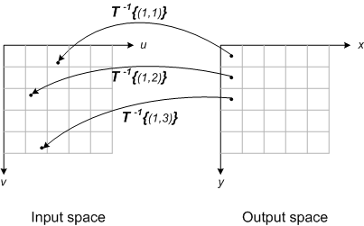
Reverse Mapping
Locate output image pixel grid somewhere in output space. Then for each output pixel on the grid:
Apply the inverse spatial transformation to determine the corresponding location in input space: (u_{k},v_{k}) = T⁻¹{(x_{k},y_{k})}.
Using the input image pixels nearest to (u_{k},v_{k}), interpolate to get an approximate value for the input image at (u_{k},v_{k}).
Use that value for the k-th output pixel.
COMSATS University Islamabad, Lahore Campus Digital Image Processing CSD 331

Slide 8
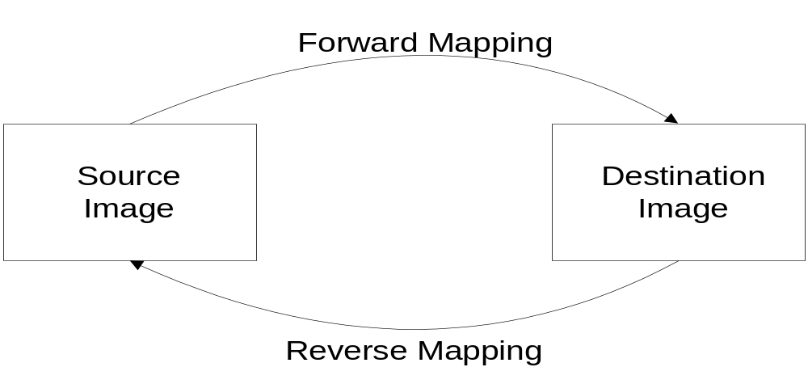
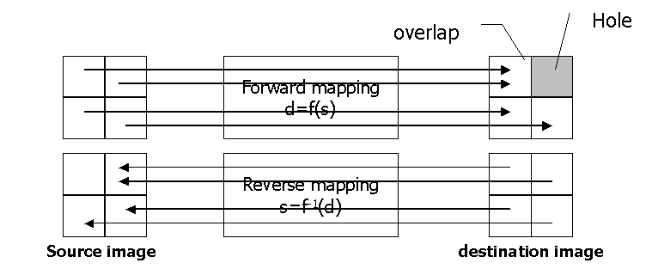
Mapping Schemes
COMSATS University Islamabad, Lahore Campus Digital Image Processing CSD 331

Slide 9
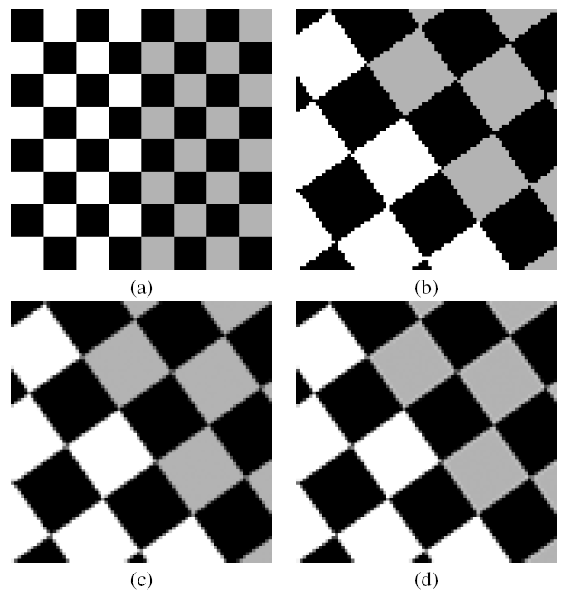
Interpolation Methods
Zero-order (nearest neighbor) interpolation
First-order (bilinear) interpolation
Higher-order interpolations (e.g., bicubic)
COMSATS University Islamabad, Lahore Campus Digital Image Processing CSD 331

Slide 10
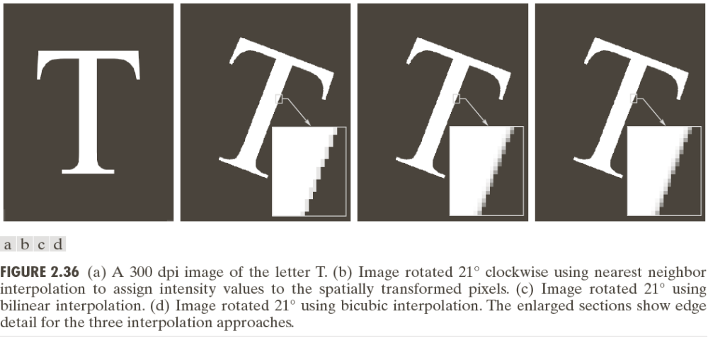
Geometric Spatial Transformations (Rubber Sheet)
COMSATS University Islamabad, Lahore Campus Digital Image Processing CSD 331

Slide 11
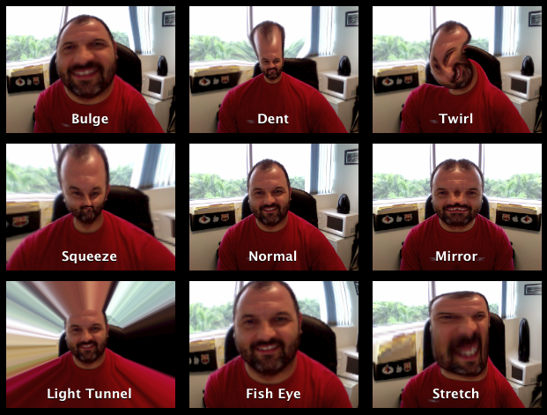
Non Linear Transformations
COMSATS University Islamabad, Lahore Campus Digital Image Processing CSD 331

Slide 12
Image Registration
Used to align two or more images of the same scene
We have to estimate the transformation function to register these images
Input image is registered against the reference image
Used to register images
  Taken at approximately same time but through different imaging systems
  Taken at different times using the same imaging system
  Taken at same time, from same imaging system but from different angles
Tie points/Control points used > Corresponding points whose locations are precisely known in the input image and reference image
Control points selected manually or automatically through algorithms
The transformation function is about pixel locations, still need to use intensity interpolation to assign intensity values to the pixels
Difficult to achieve perfect matches for control points when distortion is severe
COMSATS University Islamabad, Lahore Campus Digital Image Processing CSD 331

Slide 13
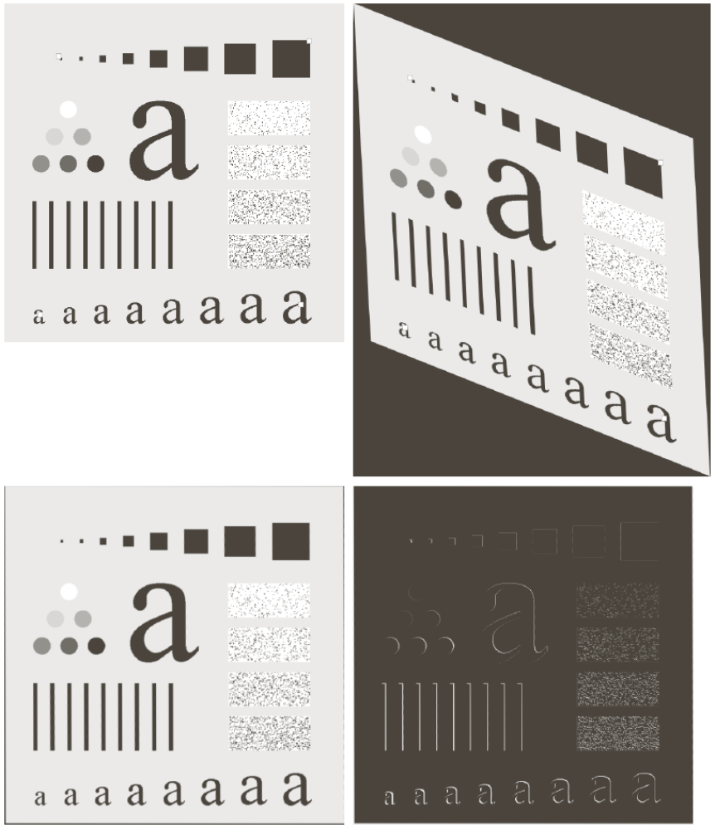
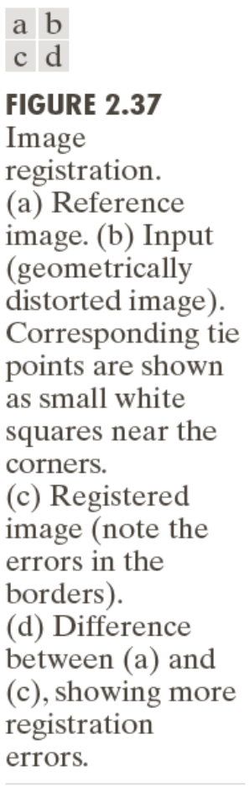
Image Registration
COMSATS University Islamabad, Lahore Campus Digital Image Processing CSD 331

Slide 14
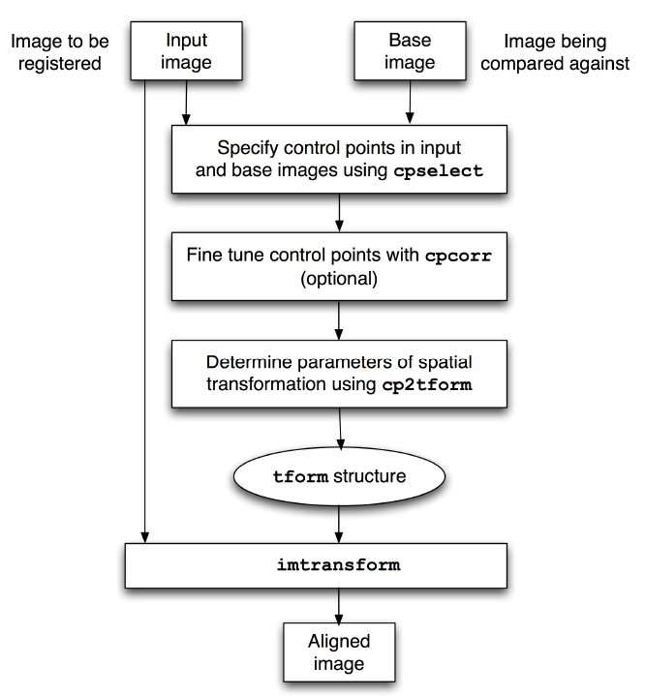
Image Registration in MATLAB
COMSATS University Islamabad, Lahore Campus Digital Image Processing CSD 331

Slide 15
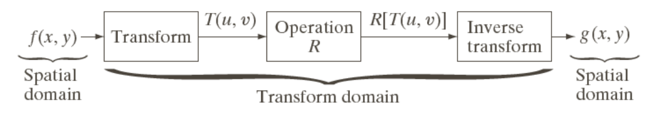
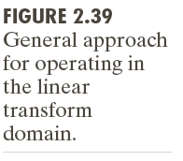
Image Transforms
img = imread('sample.tif’);
imgFFT = fft2(double(img));
img2 = ifft2(imgFFT);
S=fftshift(log(1+abs(imgFFT)));
COMSATS University Islamabad, Lahore Campus Digital Image Processing CSD 331

Slide 16
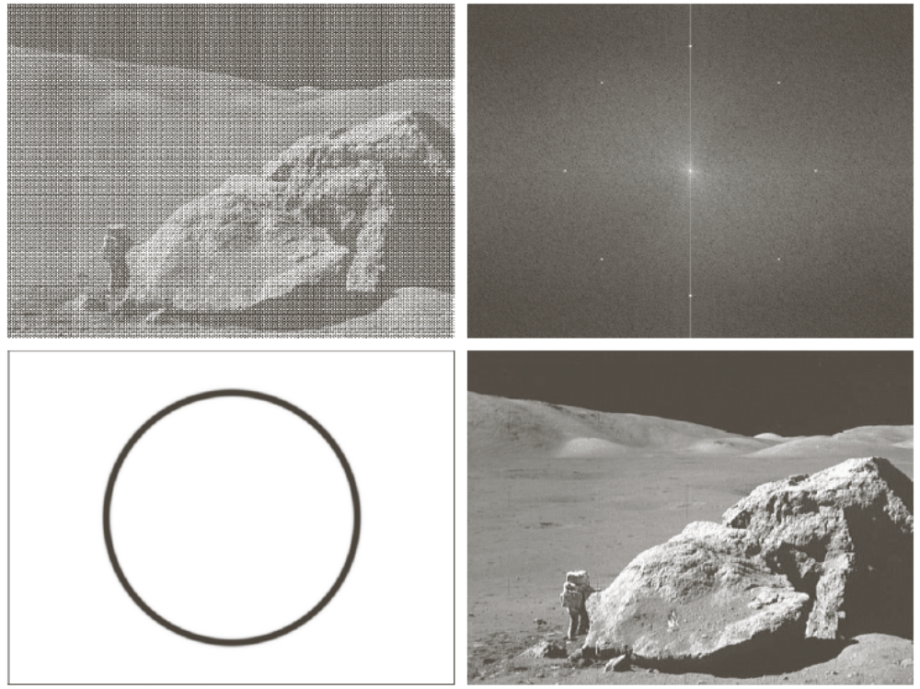
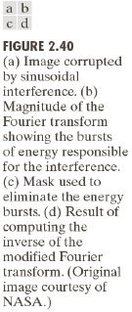
Image Transforms
COMSATS University Islamabad, Lahore Campus Digital Image Processing CSD 331

Slide 17
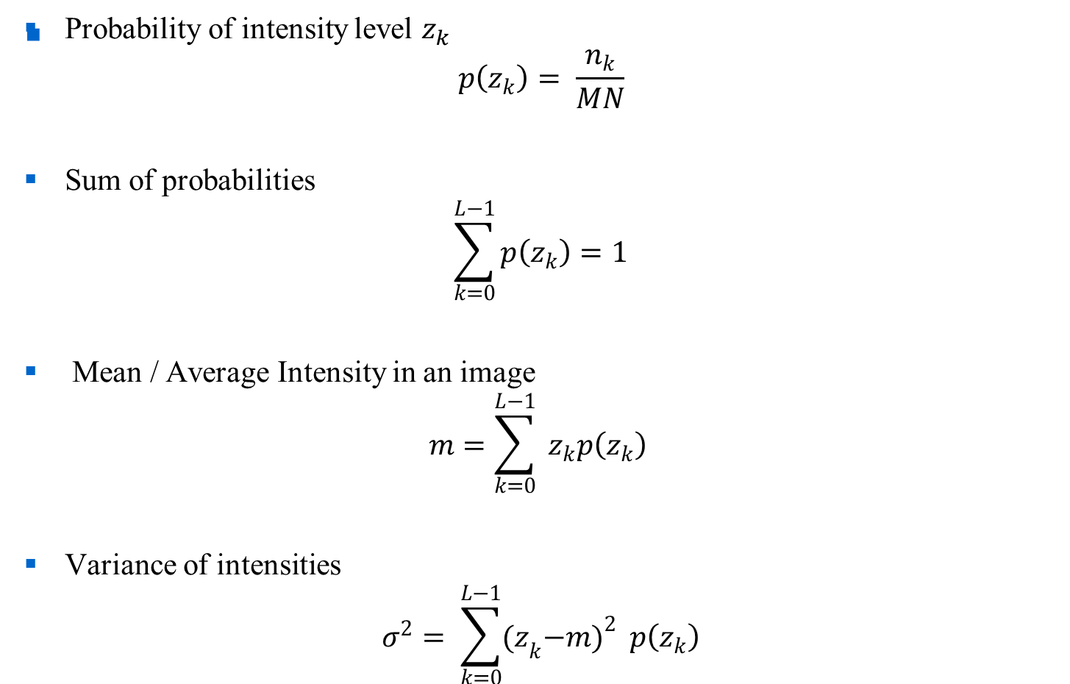
Probabilistic Methods
COMSATS University Islamabad, Lahore Campus Digital Image Processing CSD 331

Slide 18
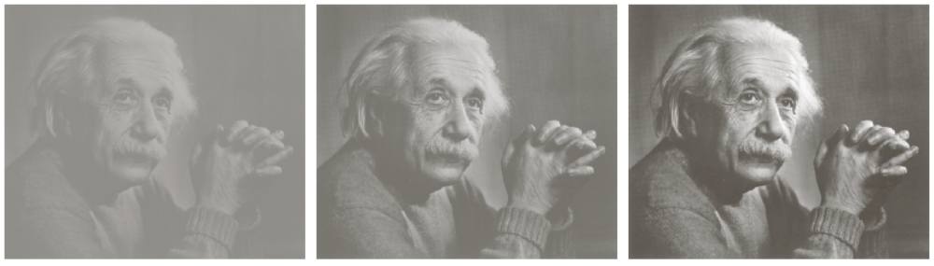
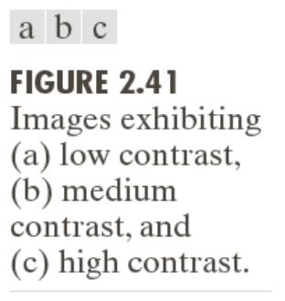
Probabilistic Methods
COMSATS University Islamabad, Lahore Campus Digital Image Processing CSD 331

Slide 19
Reading Assignment
Chapters 1 and 2 of “Digital Image Processing” by Gonzalez.
Chapter 2 of “Digital Image Processing using MATLAB” by Gonzalez.
COMSATS University Islamabad, Lahore Campus Digital Image Processing CSD 331

